Slide 1
Resilient Distributed Datasets
Matei Zaharia, Mosharaf Chowdhury, Tathagata Das,
Ankur Dave, Justin Ma, Murphy McCauley,Michael J.Franklin,
Scott Shenker, Ion Stoica
University of California, Berkeley
Presented by Jinxiaoyu Zhi, Dong Chen, Huanyu Zhao

Slide 2
Background
Different cluster computing frameworks
MapReduce, Dryad, Pregrel, etc
Flush intermediate results to disk
Inefficient for data reuse
Iterative algorithms (PageRank, K-means, logistic regression, etc)
Iterative data mining tools

Slide 3
New framework…
Resilient Distributed Datasets (RDDs)
Optimize data placement: Keep intermediate results in memory
Good fit for parallel applications
Achieve fault-tolerance efficiently
Main challenge
Provide fault-tolerance efficiently

Slide 4
Resilient Distributed Datasets (RDDs)
RDD Abstraction
Read-only, no random write
Coarse-grained transformations: map, filter, and join, etc
Logging the transformations (lineage) rather than datasets
Only be Created through operations on:
data in stable storage
other RDDs
Implemented in Spark
Users can control two aspects: persistence and partitioning

Slide 5
Spark
Spark runtime
One driver program
Defines RDDs and invokes actions
Track the RDDs’ lineage
A cluster of workers
Store RDD partitions in RAM
Language-integrated API
Transformations: map, filter, etc
Actions: count, collect
Persist

Slide 6
Example
Lineage graph

Slide 7
Spark VS DryadLINQ
Similarity
bulk operations corresponding to RDDs transformations
Provide Language-integrated API in Scala
Difference
Datasets in disks or filesystems(DryadLINQ) VS Datasets in memory(Spark)
Spark can be used interactively to query big datasets from Scala interpreter

Slide 8
RDDs VS Distributed Shared Memory

Slide 9
Applications of RDDs
Suitable: batch applications
Not Suitable: make asynchronous fine-grained updates
Storage system for Web application
Incremental web crawler

Slide 10
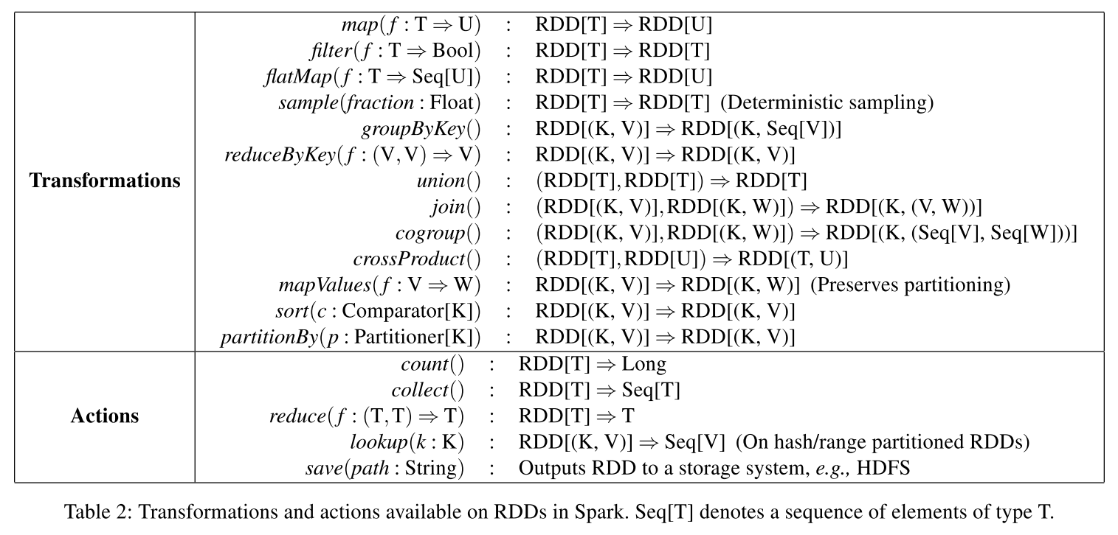
Transformations and actions
RDD{1,2,3,4}
Map(x->x+1): RDD{2,3,4,4}
Flatmap(x->x.to(3)): RDD{1,2,3,2,3,3,3}
val a = sc.parallelize(List((1,2),(1,3),(3,4),(3,6)))
a.reduceByKey((x,y) => x + y): (1, 5) (3, 10)
a.groupByKey(): (1, (2, 3)) (3, (4, 6))
Notes:
map(func) Return a new distributed dataset formed by passing each element of the source through a function func.
flatMap(func) Similar to map, but each input item can be mapped to 0 or more output items (so func should return a Seq rather than a single item).

Slide 11
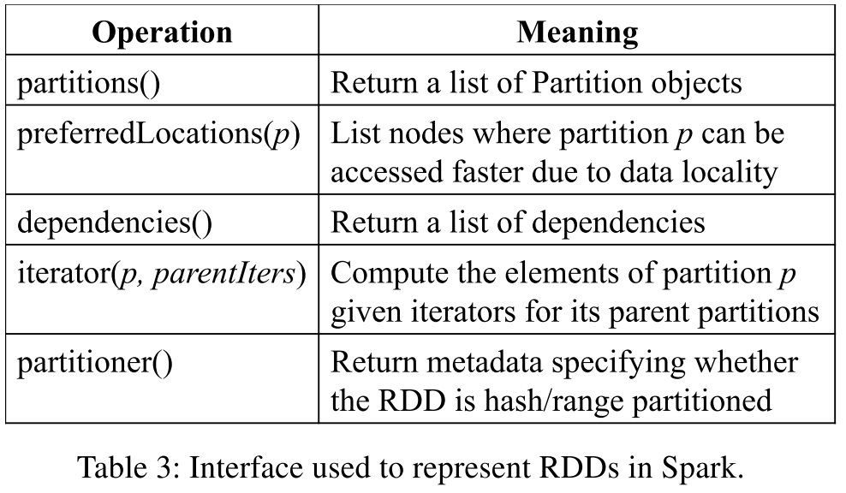
Representing RDD
Graph-based representation
Track lineage across a wide range of transformations without adding special logic.
Interfaces of RDD
Partitions, which are atomic pieces of dataset
Dependencies on parent RDD
Functions for computing the dataset based on parents
Partition schema metadata
Data placement metadata

Slide 12
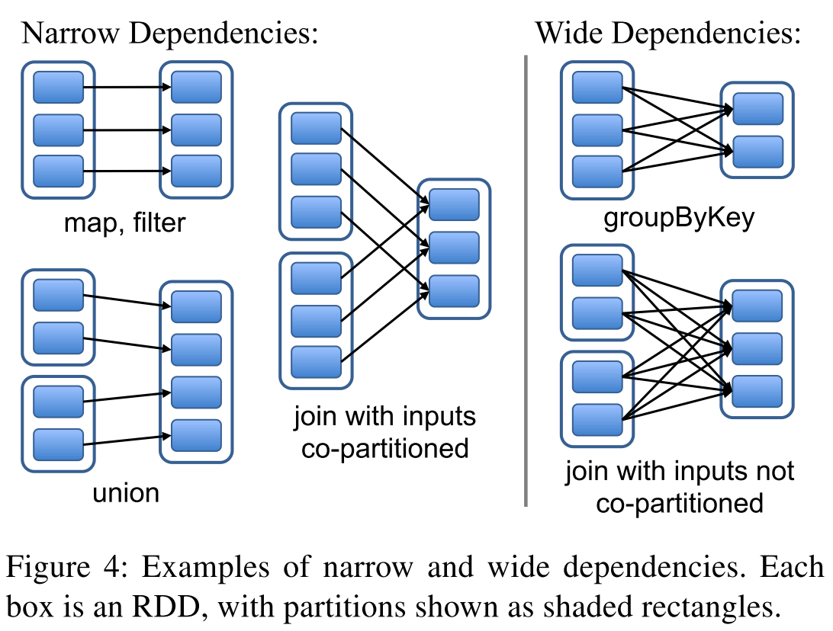
Dependencies between RDDs
Narrow dependencies
Each partition of the parent RDD is used by at most one partition of the child RDD
One to one
Wide dependencies
Multiple child partitions may depend on parent RDD
One to many
Example :
Narrow: map, filter, union, join(co-partioned)
Wide: groupByKey, join(co-partioned)

Slide 13
Differences between types of dependencies
Execution
Narrow dependencies:
Pipelined execution on one cluster node
The node can compute all the parent partitions
Wide dependencies:
Require data from all parent partitions to be available and to be shuffled across the nodes by MapReduce
Recovery
Narrow dependencies:
Only need to recomputed the lost parent partitions
Can be recomputed in parallel on different nodes
Wide dependencies:
Complete re-execution because of the loss of some partition from all the ancestors of an RDD

Slide 14
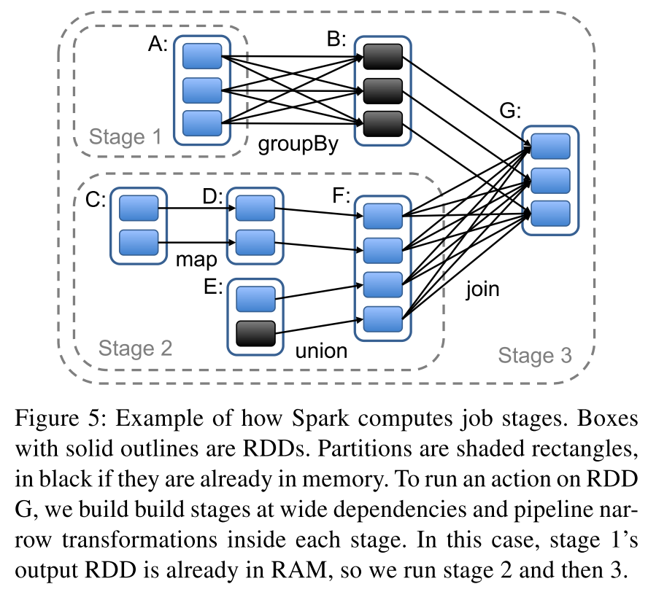
Job Scheduling- DAG
Examine RDD’s lineage graph to build a DAG(Directed Acyclical Graphs) of stages to execute
Stage contains as many pipelined transformations with narrow dependencies as possible.
Stages boundaries
the shuffle operations required for wide dependencies
already computed partitions that can shortcircuit the computation of a parent RDD
Scheduler launches tasks to compute missing partitions from each stage until it has computed the target RDD

Slide 15
Job Scheduling- DAG
Assigns tasks to machines based on data locality using delay scheduling
Partition is available in memory on a node
Partition containing RDD has provides preferred locations
If a task fails
If stage’s parents are still available
re-run it on another node
If unavailable:
resubmit tasks to compute the missing partitions in parallel.

Slide 16
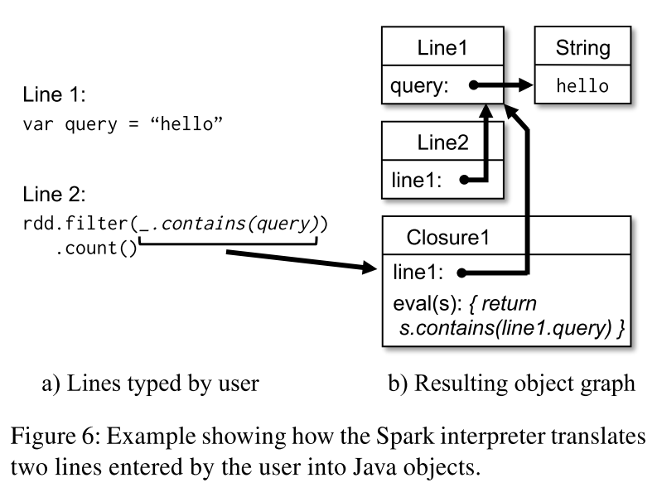
Interpreter Integration
Run Spark interactively from the interpreter to query big datasets.
Compile a class for each line
Interpreter serve these classes over HTTP.

Slide 17
Memory Management
Storage of persistent RDDs
in-memory storage as deserialized Java objects
fastest performance
in-memory storage as serialized data
more memory-efficient representation than Java object graphs
lower performance
on-disk storage
Suitable for RDDs that are too large to keep in RAM
costly to recompute on each use
LRU eviction policy at the level of RDDs
Evict a partition from the least recently accessed RDD when no enough space
If (victim RDD == new partition RDD) , Keep the old partition in memory
Most operations will run tasks over an entire RDD
Prevent cycling partitions from the same RDD in and out

Slide 18
Checkpointing
Useful for RDDs with long lineage graphs containing wide dependencies
A node failure in the cluster requires a full recomputation
Materialize intermediate records on the nodes holding parent partitions
Spark provides an API for checkpointing
User can decide which data to checkpoint
Automatic checkpointing - select an optimal set of RDDs
Read-only nature of RDDs makes them simpler to checkpoint

Slide 19
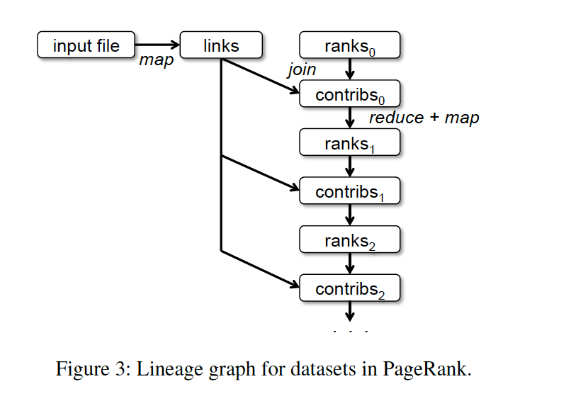

Example Applications
Logistic Regression
Function: $y={e^{(b_{0}^{}+b_{1}^{}∗x)}}/{(1+e^{\left(b_{0}+b_{1}∗x\right)})}$
PageRank
$Rank= α/N$ + (1-$α)\sum{c_{i}}$

Slide 20
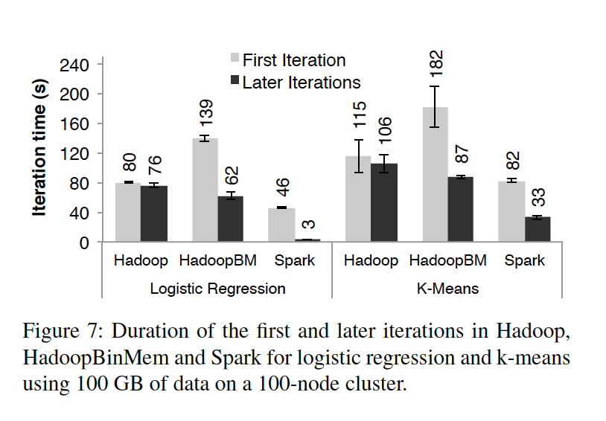
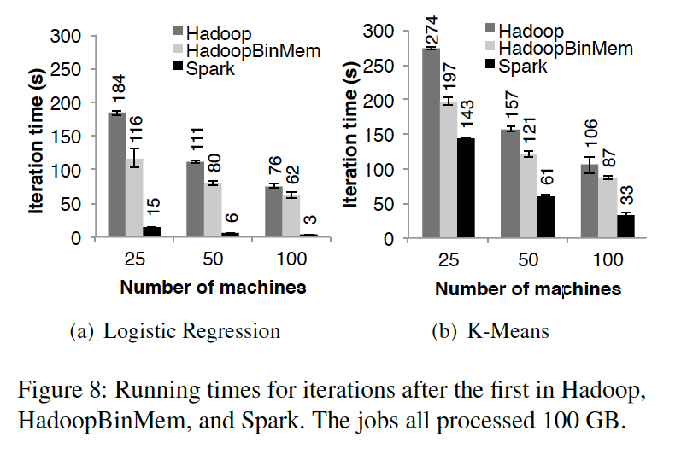
Evaluation
Iterative Machine Learning Applications
Why different speed in Logistic Regression and K-Means

Slide 21
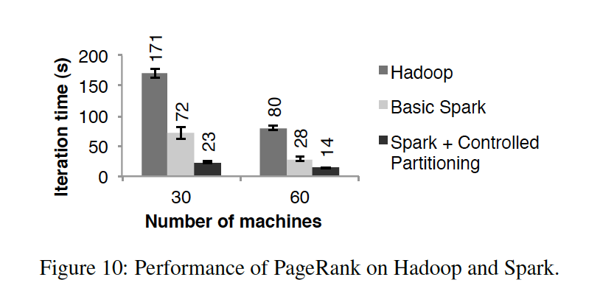
Evaluation
PageRank
How to increase the speed?

Slide 22
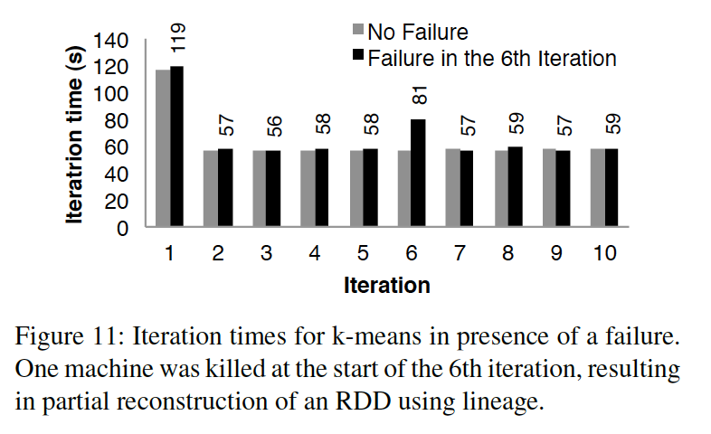
Evaluation
Fault Recovery

Slide 23
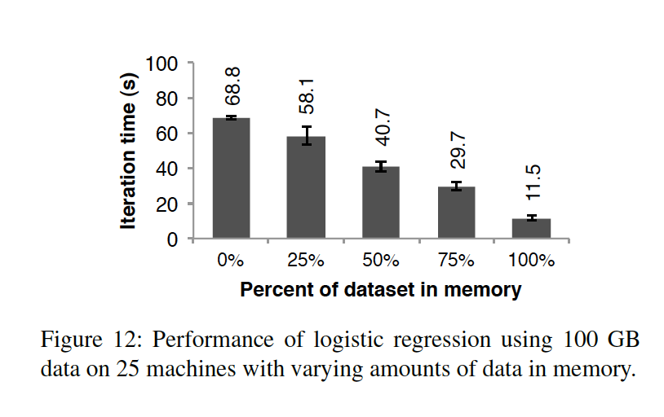
Evaluation
Memory Lack

Slide 24
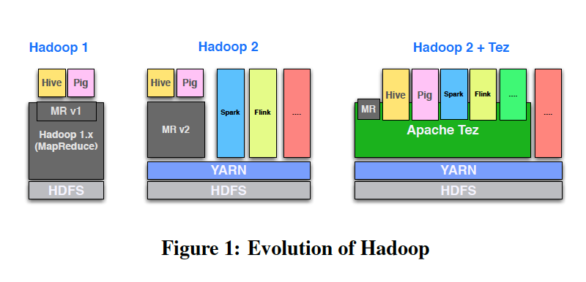
Apache Tez
Only mapReduce
A general prupose resource management layer named YARN with different function models
A common set of building blocks used by applications for their customized implementation using Apache Tez on YARN

Slide 25
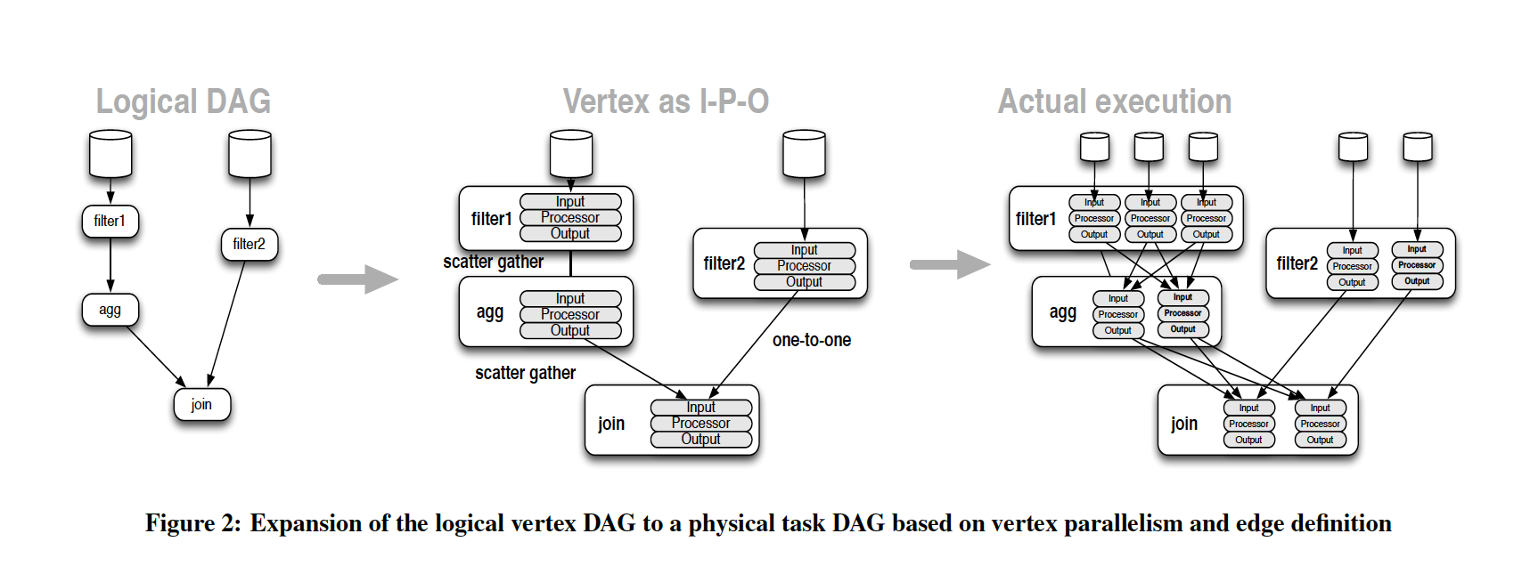
Apache Tez
DAG: Directed Acyclic Graph representing the structure of a data processing workflow. Data flows in the direction of the edges.

Slide 26
Tez vs Spark
Tez is a frame based on the YARN to implement the DAG. Which can split and aggregate the assignments to reduce the data storage in the process to speed up.
Spark is a frame based on Memory, which can store the data in the Memory to speed up the iterative calculation and the interactive data mining.

Slide 27
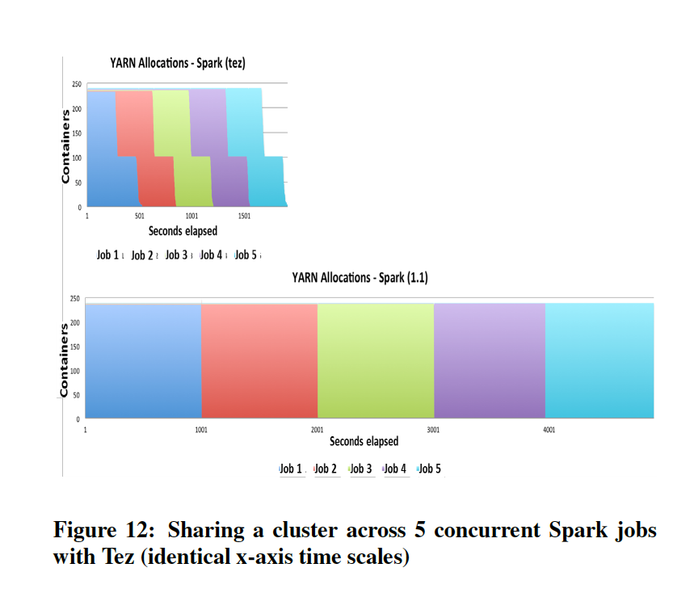
Apache Tez

